Slide 1
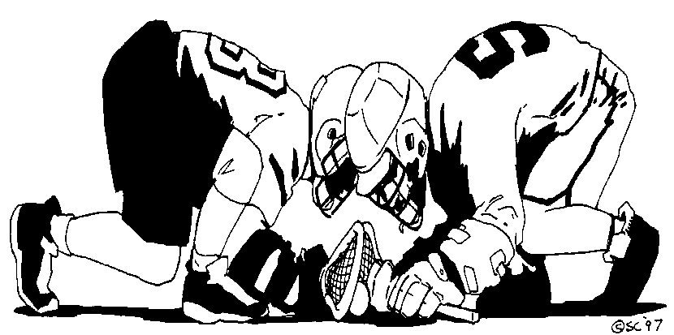
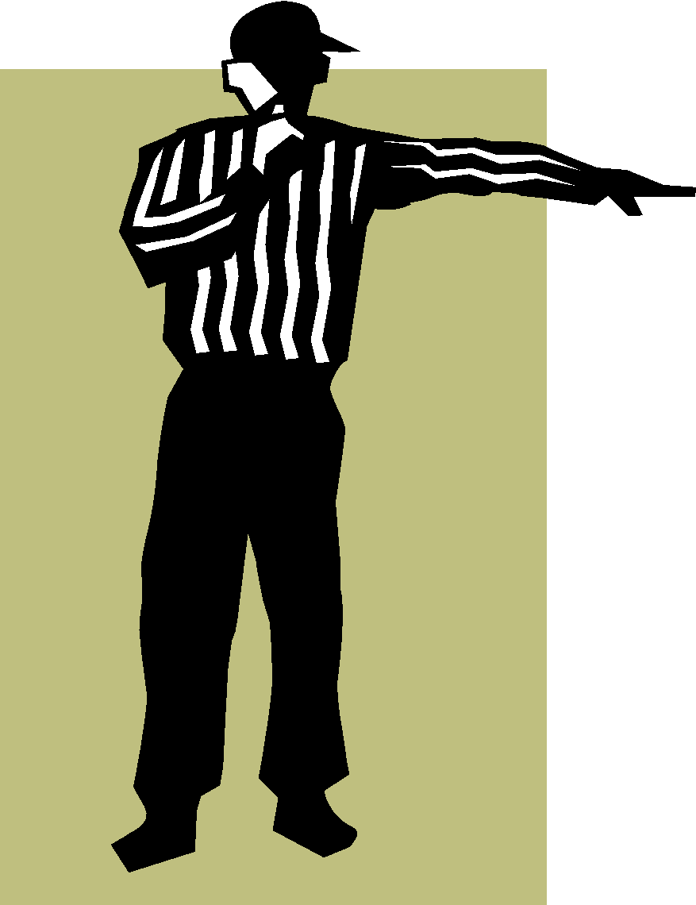
Faceoff Training
KLOA Officials Clinic
March 1, 2020
David Tripp and Dennis Runyon

Slide 2
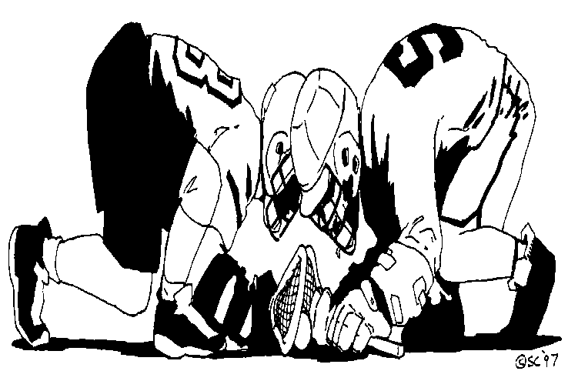
Agenda
Prior to the Faceoff
Center Ref Mechanics
Three man Faceoff Mechanics
Two man Faceoff Mechanics

Slide 3
2020 Rules
Page 31-Rule 4-3, Art. 3a..….”The official shall indicate to the players the spot on which the faceoff will take place and instruct the players to prepare for the face-off by saying “down.”
Art 3c “ The crosses and gloves shall rest on the ground along the centerline, parallel to each other up to, but NOT touching the center line”

Slide 4
2020 Rules continued
Page 32-Rule 4-3, Art. 3d-”…”The official shall make certain that the reverse surfaces of the crosses match evenly in that the top of one head lines up with the throat of the other and are perpendicular to the ground…” Hands wrapped around the cross and touching the ground. EVERYTHING has to be to the left of the throat of his stick. Feet may not touch the stick. Right hand may not touch the any part of the head of the stick. It is legal over the centerline of the stick but not in the neutral zone!
“It is illegal to kick, step on, or intentionally place any other body part on his crosse or the opponent’s crosse. It is illegal for a faceoff player to use his crosse to hold or pin down the crosse of his opponent.”
What is the penalty? -
Technical Foul – Illegal procedure.

Slide 5
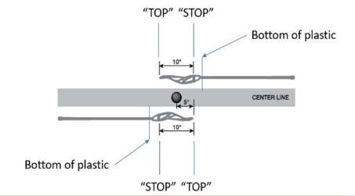
Crosse Position

Slide 6
2020 Rules Cont.
2020 Rules Cont.
Answer the following:
*It is okay to touch the ball with your hand as long as it is wrapped around your stick?
TRUE
*It is illegal to clamp the ball?
FALSE
*No need for any contrasting color between the glove-shaft-head of stick?
FALSE
*It is still okay to carry the ball in the back of your stick as long as the ball freely comes out when attempting to dislodge the ball?
FALSE
*You get two shakes to dislodge the ball from the back of your stick?
NO, this was never the case!!!!! You get one step

Slide 7
2020 Rules continued
Page 32 Rule 4-3 art. 3l…it is illegal for a player to deliberately use his hand or fingers to play the ball.
This shall be enforced immediately as an unsportsmanlike conduct penalty.
Page 32 Rule 4-3 art. 3m…It is illegal for a player to grab an opponent’s crosse with the open hand or fingers.
This shall be enforced immediately as an unsportsmanlike conduct penalty.
Note: Inadvertent touching of the ball when the hand is grasping the stick should not be called as an unsportsmanlike conduct foul.

Slide 8
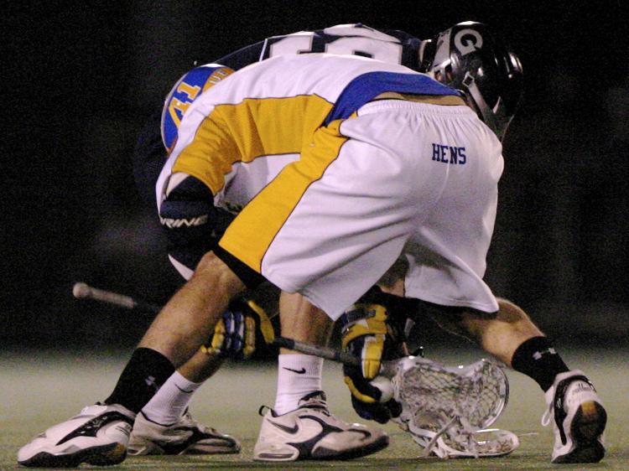
Where’s the Ball?
What’s the Penalty?

Slide 9
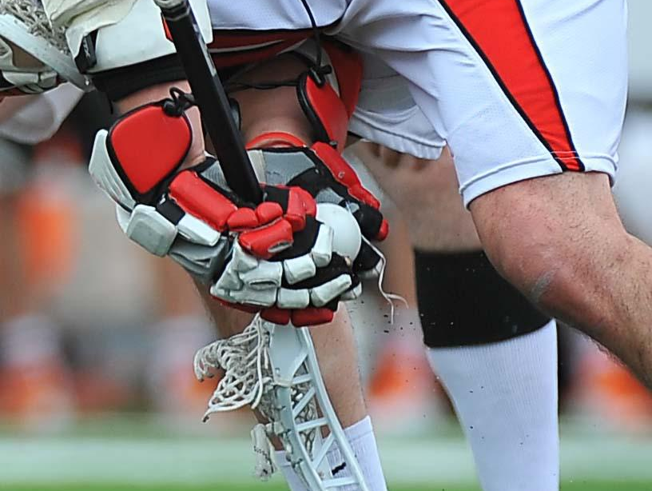
The Penalty is Unsportsmanlike Conduct.
HOME
VISITOR
Why FO needs to “stay home”…
XXXXX
OOOOO
Notes:
A new twist on an old trick- Note the position of the official! (Somehow, he managed to spot this and make the call.) What’s the penalty for this in 2010? USC!!

Slide 10
Prior to the Face-off
In your pre-game with the other official(s):
How does the R want to administer faceoffs?
How much do you “talk to” the faceoff middies?
How tight do you want to manage faceoffs?
Based on skill & level, time in the season.
Review the roles of the other referee(s)
The objective is to be consistent throughout the game between all officials!
In your pre-game with the coaches & players:
Is everyone aware of the rules? Questions?
Prior to the opening faceoff at Center X:
What do you say to the faceoff middies?

Slide 11
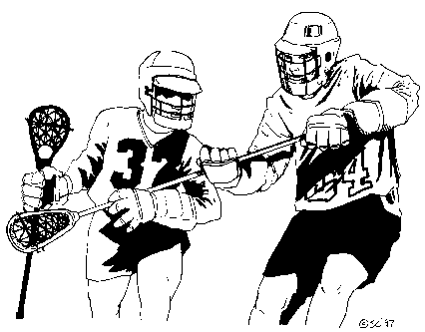
Center Referee Mechanics
Stand with the ball at center X.
Look for the signal that the crew is ready.
Give the “Down” command
Sticks perpendicular to the ground and parallel to the midfield line.
Sticks equidistant, up to but not touching the midfield line.
Gloves completely around the stick, on the ground, and not touching the stick head or strings.
Verify you can clearly see a contrasting color between the glove and the head of the stick.
Nothing in the “neutral zone” or “cylinder”, esp. helmet.
Entire body to the left of the stick head, esp. helmet, foot, or leg.
How & when do you “reset the players” vs. call the violation?

Slide 12
Face-Off Official
HOME
VISITOR
Center Referee Mechanics cont.
XXXXX
OOOOO
Keep your free arm at your side. Keep the whistle in your mouth, or place it to your mouth as the players go down together!
Position yourself where you are safe and can see sticks.
Put players down together, putting your whistle to your mouth as they go down. Adjust the players as needed until you are satisfied with the sticks.
Place the ball in the middle of the sticks! Say “set”! Back out, blow your whistle .
Vary your whistle cadence!
If there is a pre-whistle violation don’t blow your whistle. Tell the players to stand up. Signal (but do not say) illegal procedure, verbalize exact violation, and award possession.
Conduct the restart after a violation.
Stay stationary once faceoff begins. You are easier to avoid if you are not moving. Watch face-off action for violations.
Updated 6/21/05

Slide 13
Face-Off- Wings
HOME
VISITOR
Wing Officials
XXXXX
OOOOO
Lead Left: as close to center as necessary.
Don’t move between “Down” and whistle.
Single side official conducts the face off.
Move toward your goal on the whistle.
Single side has all counts!
Lead left official helps with what the Single side official can not see. For example, the back hand of the closest face off man.
Help with any pre-whistle violations.
Updated 6/21/05

Slide 14
Three Man Mechanics
After a goal:
Goal line official retrieves and keeps the ball and proceeds to the center “X” to conduct the face-off. What player scored the goal?
Single side moves to bench side. If he is the new Lead Left then he helps on the face-off. Trail official remains bench side and watches the substitution box. Chops his arm to signal and starts the 20 second timer once the face-off official give the ready to play signal.
Before the “Down” command is given:
Trail and lead officials counts players with arms raised. Points towards his goal when he’s ready. Single side has all counts on the faceoff!
Bench side officials watch for wing and offensive zone violations. They help Center X with the faceoff middies when needed.

Slide 15
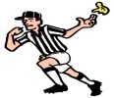
Face-Off Standard Position
HOME
VISITOR
XXXXX
OOOOO
Lead Right Responsibilities
- wing line violations
- goal line coverage
- move on whistle
- some possession calls
- beeper to start play
- time outs
- line violations
Lead Left Responsibilities
- butt end facing him
- wing line jumps
- goal line coverage
- move on whistle
- some possession calls
- line violations
- Stick alignment
Center Responsibilities
- position as needed
to be safe & see sticks
- neutral zone
- stick heads
- handles of crosse
- gloves on crosse
- most violations
- most possession calls
- rotate with f/o players
Notes:
Teaching Tips
-Note new references for F/O- F/O, B, SS
- Face-off official position flexible
- Be still once you put the players down
- ball stays at center- stay home

Slide 16
Ball moves to left
HOME
VISITOR
XXXXX
OOOOO
Lead right becomes Lead
- has goal line &end line
Lead Left becomes Trail
- determine possession
- sweep box
- jog into play
- If FO violation, restart play quickly.
Ball
Single-Side
- don’t stop at cone!
- 20/10-second counts
- help on questionable goal

Slide 17
HOME
VISITOR
XXXXX
OOOOO
Lead Right becomes Trail
- offside
- substitutions
sweep box
time-outs
jog into play
Lead Left becomes Lead
- stay outside of passing
lanes getting to GLE
- verbally call off Single
- covers goal and endline
Ball
Single
- 20/10-second counts
- help on questionable goal
- stays on goal until called off by Lead
Ball moves to right
Notes:
Teaching Tips
- FO/L: Get into position as soon as you can, but stay out of
passing lanes

Slide 18
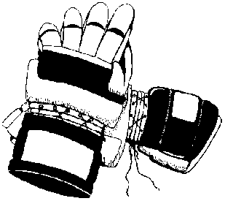
Two Man Mechanics
After a goal:
Goal line official retrieves the ball and flips to trail. He remains on the same side of the field. What player scored the goal?
Trail takes the flip and goes to X for the next face-off and crosses mid-field. Indicates to the other official that he is ready.
The “non-faceoff” official chops his timer on and watches substitutions.
Before the “Down” command is given:
The “non-faceoff” official counts players with arms raised. Points when ready. This official also has wing violations on both wings.

Slide 19
Ball moves to left
Wing Official lines up on wing
line near the restraining line. After
whistle he becomes Trail and heads to top corner of opposite box
Wing
Ball
Center
Center has initial 10 count and goal at his end. Hustle to get good goal coverage.

Slide 20
Ball moves to right
Wing official becomes lead
Covers the goal and the endline.
Ball
Wing
Center
Note: Center has all initial counts.
Center is now the trail and tries to get outside of the play.

Slide 21
Have fun and enjoy yourself!
Have a GREAT season!

