Slide 1
Two-Person Mechanics
Notes:
This presentation is best viewed along with the US Lacrosse Two-Person Mechanics Manual.
Download Printable PDF:
https://uslacrosse.arbitersports.com/front/108525/Site/Page-Content/mensresources
Diagram Key:
R = Referee
U = Umpire
L = Lead Official
T = Trail Official
F = Faceoff Official
W = Wing Official
G = Goalkeeper
D = Defenseman
M = Midfielder
A = Attackman
C = Coach
Like our Facebook page and comment on videos and rule quizzes with officials from all over the country at facebook.com/menslaxofficials.

Slide 2
Mission of our Mechanics
Position
Safety
Fairness
Consistency
Notes:
Mechanics put officials in the best position to make the necessary calls to keep the game safe and fair by using methods that are easily applied in a consistent manner.
Position – The best spot to be in for most game situations. Hustling to your next spot is one of the best ways to show the clinicians that you are focused on the game and giving your maximum effort.
Safety – Priority number one for all officials in every game. Make the necessary safety calls when you see them.
Fairness – Your technical foul knowledge and game awareness factor heavily in a fair game. Address issues that unfairly give a team an advantage.
Consistency – Endeavor to make the same calls on each half of the field from the first whistle till the last. Communication with your partner is essential to crew consistency for an entire game.

Slide 3
Lead and Trail - Responsibilities
Lead
Goal
End Line
Trail
Shooter
Far Goal
Over and Back
T
L
Notes:
Lead Official:
Goal is primary responsibility
Positioned roughly a step or two above or below GLE
Covers the end line on contested plays
Trail Official:
Watches the shooter for late hits
Moves toward the goal if the Lead official moves to the end line
Can assist with crease violations on a tight play
Watches for contested substitutions
Makes the over and back call if necessary
Covers the far goal
Note: The pre-game should be clear on each responsibility, but the most important is that the Trail official watches the shooter on every shot.

Slide 4
Field Coverage – On and Off
T
M
L
Notes:
On Official: Has a narrow focus that is on the player in possession and surrounding 5 yards. Watches for fouls like pushing, holding, tripping, illegal body checks, unnecessary roughness, slashing, and warding.
Off Official: Has a wider view of the play because off ball involves more players in a larger area. Watches for fouls like interference, illegal offensive screens, crease violations (cutters running through the crease), and late hits after passes.
Both Officials: The officials move as if they are connected on a string. As one moves out, the other moves in.
Note: The pre-game should be clear on how On/Off calls are communicated, especially in the transition area between officials. Typically, if a player is running towards you then you are about to be the On Official.
“Cut down the distance between your present location and the place where impending action may take place. Aside from always trying to get as close to the crease as possible at any time, situations where a midfielder is barreling down the lane towards goal, or when attacker bobs and weaves through the thicket of defensemen to get between them and the crease, are exactly the times when the Lead should break out his John Deere and mow that lawn between him and the net.” – John Bistowski, LAREDO Clinician

Slide 5
Goal Scored to Faceoff
L
W
F
T
Notes:
Lead Official:
Sounds whistle once the ball crosses the entire goal line
Runs in and faces action. Stops and signals goal
Retrieves ball from net (goalkeeper NOT REQUIRED to get the ball out)
Hands ball to Trail official near restraining line
Jogs to position and gets ready for next faceoff
Trail Official:
Watches the shooter on the shot
Jogs toward the attack box after the whistle while watching the crease area for late hits or other fouls
Receives ball from Lead official and confirms the goal scorer
Jogs to position and gets ready for next faceoff
Note: Trail should step over midfield to take the faceoff. This will ensure that you are facing the proper direction and can see your partner near the wing line.
Note: Do not catch the ball with your hat or one-hop the ball to your partner. Either hand the ball or give a short toss.

Slide 6
Ball Away from Faceoff Official
W
L
T
F
Notes:
Faceoff Official:
Holds onto the ball and looks to Wing for ready signal
Gives “down” command
Adjusts the players’ bodies and crosses until satisfied
Gives “set” command with hand on the crosses
Backs away and sounds whistle while focused on the faceoff
Wing Official:
Take position roughly 5 yards into the field at end of wing line
Alerts partner of any man-down situations
Signals ready when field is set
Watches for wing midfielders leaving early and interference/holding
Note: The Trail official has the initial count after possession, 10 or 20 (NFHS) or 30 (NCAA). This allows the Lead official to get to the goal without worrying about the count.

Slide 7
Ball toward Faceoff Official
T
W
F
L
Notes:
Note: The faceoff official works to stay out of the developing play. If stuck, do not make the situation more dangerous by moving. Allow play to move past you and then hustle to position.
Note: A good discussion in a pre-game is when to reface and when to award via alternate possession; also review when a faceoff is considered to be over according to the rules.

Slide 8
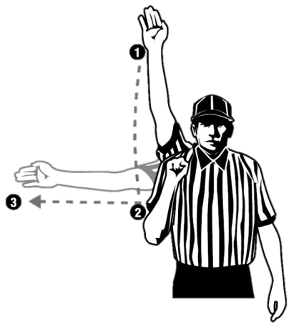
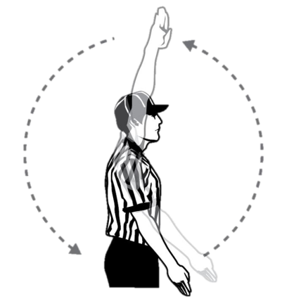
Out of Bounds and Restarts
T
L
Notes:
Each official is responsible for the end line behind the goal they cover as the Lead official and the sideline they run along.
Signaling Out of Bounds:
Sound whistle while signaling dead ball with one hand in the air
Signal direction of play and call out the color of the team
“Blue” or “Blue ball!”
Place hand back into the air to signal dead ball
Slow Restart:
Count the players
Look to partner for ready signal
Don’t blow through the Stop Sign (“not ready” signal)
Quick Restart:
Don’t need to count and should make eye contact with partner
In settled play the official closest to the ball usually takes the restart
Note: Try not to point across your body as it is harder to see a cross-body signal from a distance.

Slide 9
Deep Restarts
L
M
T
Notes:
Trail Official:
Looks to Lead official for the ready signal if slow restart
Jogs up the field with or slightly behind the ball
Counts forward for offside
Has the 20-second clearing count
Lead Official:
Sets an initial position based on:
Game situation
Team tendencies
Personal mobility
Signals when field is ready
Responsible for the first offside
Stays one line ahead of the ball
Has the 10-count when the ball crosses midfield with player possession
Note: The goal must be covered as the new Lead official in transition. If you have to give up the midline on a deep throw then run to your goal and allow your partner to worry about offside.

Slide 10
Slow Break
T
M
L
Notes:
New Lead Official:
Backs up while keeping eyes on the play
Gets to one line ahead of the ball and scans the field
Has the 10-count once ball crosses midfield with player possession
New Trail Official:
Has the 4-second crease count and 20-second clearing count
Moves outside the developing play and follows the clear up the field

Slide 11
Fast Break
T
M
L
Notes:
New Lead Official:
Sprint to cover your goal. Allow your partner to pick up the offside
Has the 10-second count when ball crosses midfield
Note: You may need to keep your eyes on the shooter if your Trail official is not yet in position.
New Trail Official:
Has the 4-second crease count and 20-second clearing count
Make sure all additional action has ceased and then hustle to your position
Count forward when determining offside
Note: Do not leave your partner hanging. Hustle to your next position and tell your partner. It is a one-person game during a fast break until the Trail gets into position.
“The game moves fast, so slow it down. That was something my supervisors consistently said to me: Slow it down and let the game come to you.”
– Mike Liner, NCAAF

Slide 12
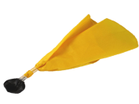
Penalty Relay
Relay
L
M
D
T
C-NOTE
Notes:
Official witnessing penalty throws flag and yells “flag down!” Partner echoes the call.
Stop play when the rules require you to do so.
After stopping play:
Confirm foul and penalty time with partner
Trail almost always reports the foul and uses C-NOTE
If on far side come toward the middle of the field
If on bench side go no further than the wing line to report
Partner gets the field set for the restart and informs goalkeeper the length of penalty and where the ball is before the restart
Before restarting play:
Confirm when the penalty will release
Ex. “all even at 6:15”
Count both teams
Note: It may be necessary to walk into the table area to confirm multiple penalties or more complicated situations with the penalty timer.

Slide 13
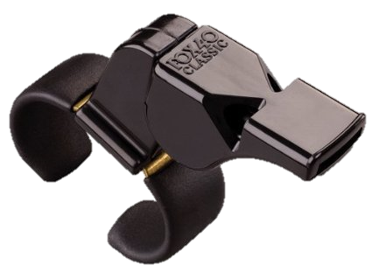
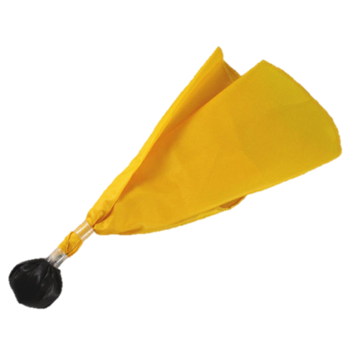
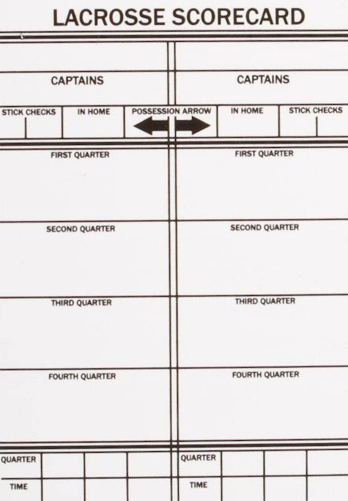
Fights
Fight!
L
M
D
Freeze!
T
Notes:
Closest official:
Runs toward the players fighting and continuously circles them while blowing the whistle. This keeps other players from entering into the fight and a whistle blown loudly at close range will get the attention of the fighting players. Communicate that you want the players to stop fighting in between whistle blasts.
Note: Physically separating players should only be done if you judge that you can do so without endangering the safety of the players or yourself.
Furthest official:
Get to a space near the benches and loudly shout “Freeze!” while spreading your arms. Repeat that often and instruct the coaches to assist you in keeping the players in their bench areas. Once the benches are frozen turn to your partner and record the numbers of all players involved in the fight.
“If they played by the honor system, they wouldn’t need us.” – Author Unknown

Slide 14
Coin Toss
R
U
H
H
H
V
V
Notes:
Referee gets the home captains, Umpire gets the visiting captains. Identify who the speaking captain is and that captain stands closest to the Referee.
Referee speaks to the captains:
Introduces the crew
Asks captains to shake hands
Shows coin to both speaking captains
Explains coin flip procedure and what to do if coin is dropped
Asks visiting team speaking captain to choose “heads” or “tails”
Coin is tossed and caught with open palm
Winning team gets:
Choice of goal to defend first, OR
First Alternate Possession (AP)
After the toss:
Players rotate so backs are to the goal they will defend first
Referee taps team that has first AP on the shoulder

Slide 15
Equipment Checks
Focus
T
L
M
M
M
M
M
M
M
M
Notes:
Each official:
Go to a player and ask for their crosse
Check the required equipment of each player
Meet at or near Center X and check both crosses
One official should make sure to have a ball
Note: One official faces the benches and keeps eyes on the players. Some officials prefer that the Referee faces the benches while others prefer that the Umpire does. It does not matter as long as one official is watching the benches, and this preference should be communicated in the pre-game discussion.

Slide 16
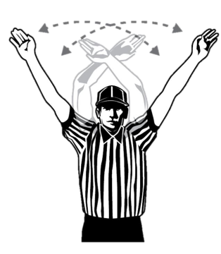
Timeouts
L
D
M
A
D
T
Timeout!
C
C
M
M
M
M
M
M
Notes:
Anticipate timeouts calls:
End of quarter
Clear with long pole under pressure
Winning team pressured with less than two minutes in game
First possession in overtime
Note: A time out is granted as soon as the official recognizes it. If the ball is loose by the time you blow the whistle, but the player had possession when the coach called for time out, get big and signal timeout and say: “While the player had possession!” That will help clear up any confusion.

Slide 17
uslacrosse.arbitersports.com
facebook.com/menslaxofficials
Notes:
The US Lacrosse Central Hub at uslacrosse.arbitersports.com is your one stop shop for men’s officiating memos, articles, videos, downloadable resources, and rules tests. You can also find applications to this year’s LAREDO clinics.
Follow the Men’s Officials Education Program on Facebook at facebook.com/menslaxofficials

